Slide 1
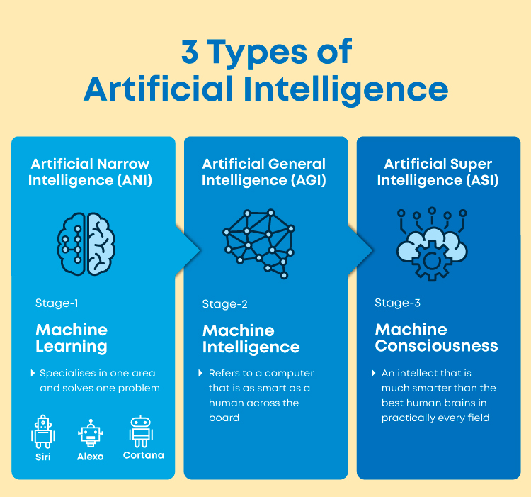
https://www.mygreatlearning.com/blog/what-is-artificial-intelligence/
Master in Artificial Intelligence – EST-IPCA - 2024

Slide 2
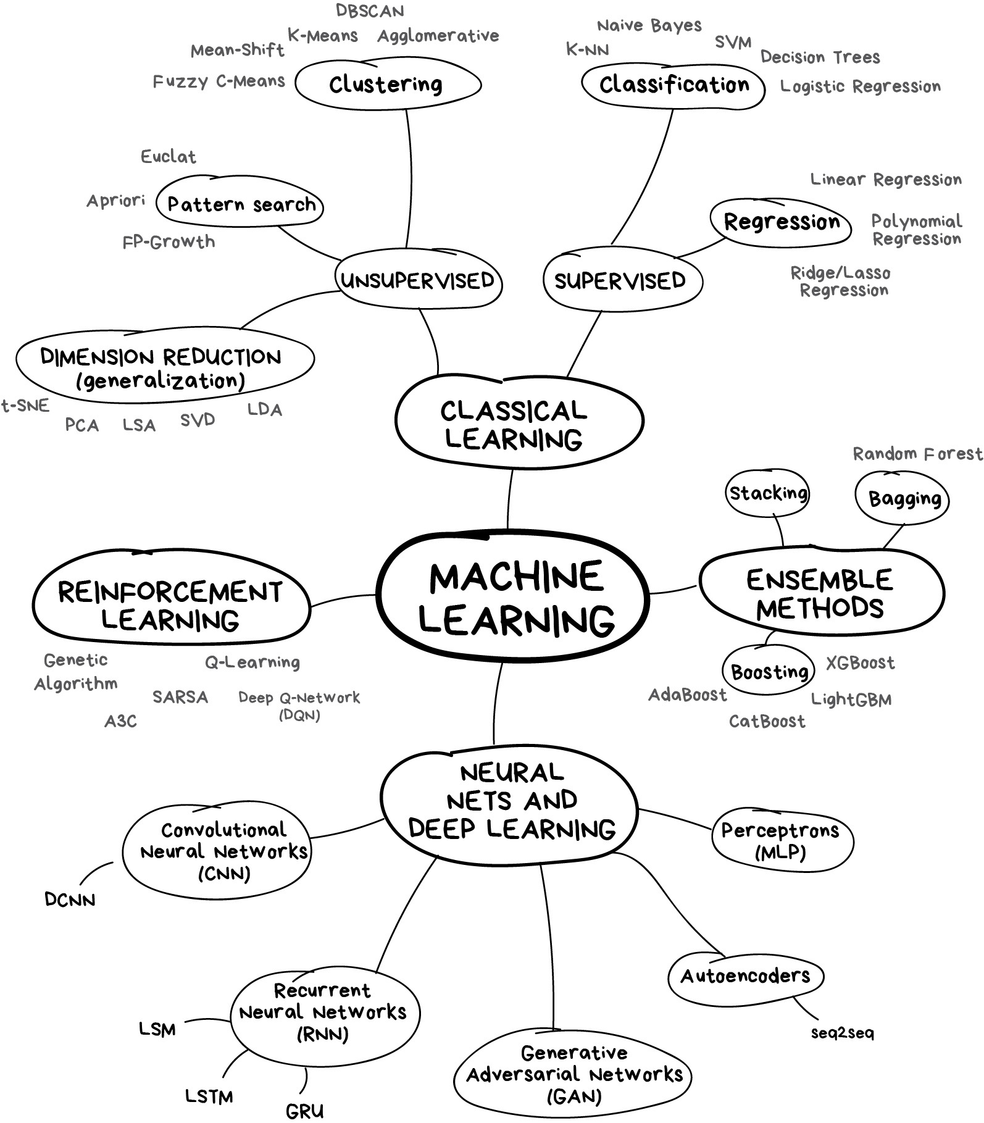
https://vas3k.com/blog/machine_learning/
Master in Artificial Intelligence – EST-IPCA - 2024

Slide 3
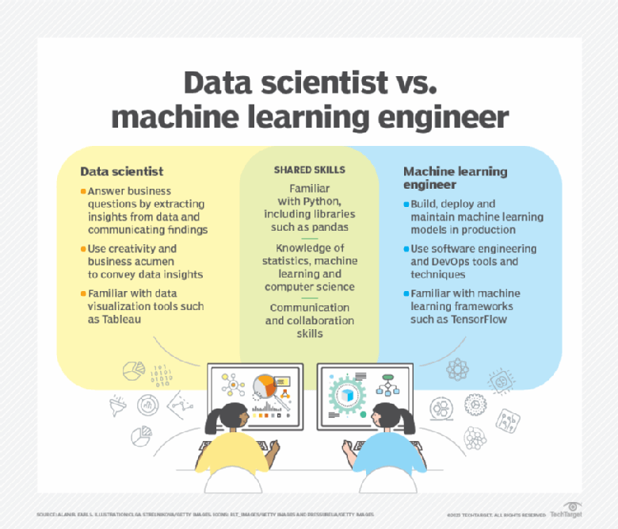
Master in Artificial Intelligence – EST-IPCA - 2024

Slide 4
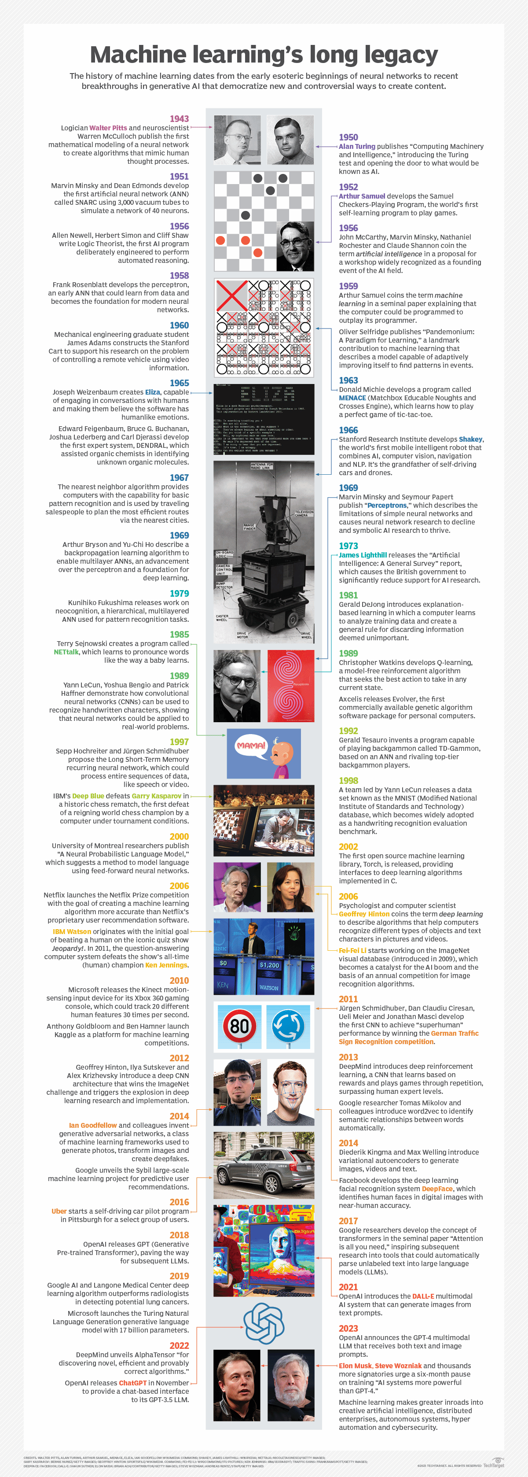
Master in Artificial Intelligence – EST-IPCA - 2024
Notes:
https://www.techtarget.com/searchenterpriseai/definition/machine-learning-ML

